Slide 1
Module 4: Design Concepts
Roger S Pressman
Chapter 8 & 9
- Dr. Samriddhi Sarkar, SCOPE, VIT Vellore

Slide 2
Contents
Design concepts and principles - Abstraction - Refinement - Modularity (Cohesion coupling)
Architectural design,
Detailed Design
Transaction Transformation,
Refactoring of designs,
Object oriented Design User-Interface Design

Slide 3
Design Principles
Software Design is the process of transforming user requirements into a suitable form, which helps the programmer in software coding and implementation.
the design document is produced, based on the customer requirements as documented in the SRS document. Hence,
This phase aims to transform the SRS document into a design document.
software design is the last action within the modeling activity and sets the stage for construction (code generation and testing).

Slide 4
Contd…
The following items are designed and documented during the design phase:
Different modules are required.
Control relationships among modules.
Interface among different modules.
Data structure among the different modules.
Algorithms are required to be implemented among the individual modules.

Slide 5
Contd…
The software design process can be divided into the following four-levels or phases of design:
Interface Design
Architectural Design
Data/Class Design
Component-Level Design

Slide 6
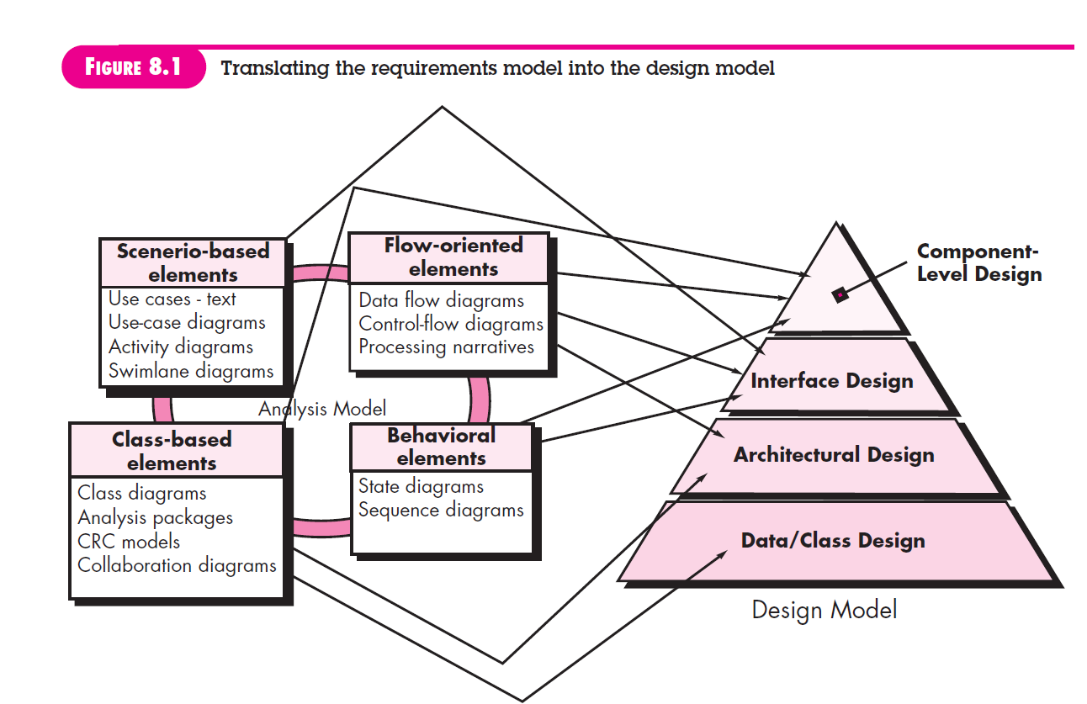
Translating the requirements model into the design model

Slide 7
Objectives of Software Design
Correctness: it should correctly implement all the functionalities of the system.
Efficiency: resources, time, and cost optimization issues.
Flexibility: ability to adapt and accommodate changes easily.
Understandability: easily understandable, it should be modular, and all the modules are arranged in layers.
Completeness: The design should have all the components like data structures, modules, external interfaces, etc.
Maintainability: easy to understand, modify, and maintain over time.

Slide 8
THE DESIGN PROCESS
Software design is an iterative process through which requirements are translated into a “blueprint” for constructing the software.
1. Software Quality Guidelines and Attributes: the quality of the evolving design is assessed with a series of technical reviews discussed.
The design must implement all of the explicit requirements contained in the requirements model, and it must accommodate all of the implicit requirements desired by stakeholders.
a readable understandable guide for those who generate code and for those who test and subsequently support the software.
a complete picture of the software, addressing the data, functional, and behavioral domains from an implementation perspective.

Slide 9
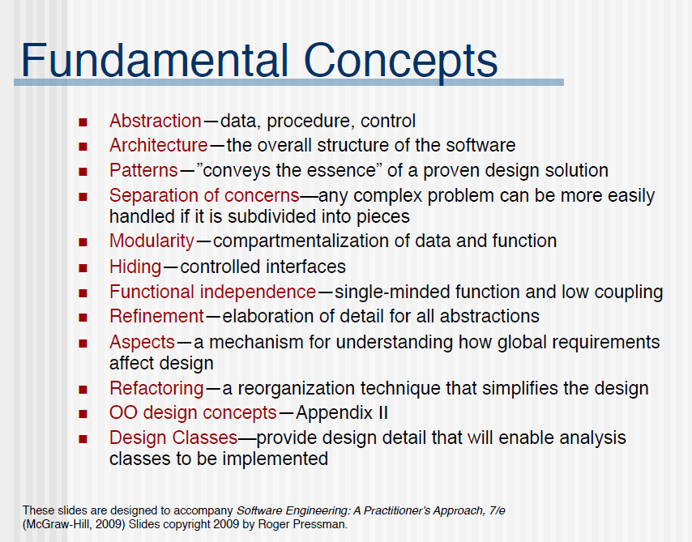

Slide 10
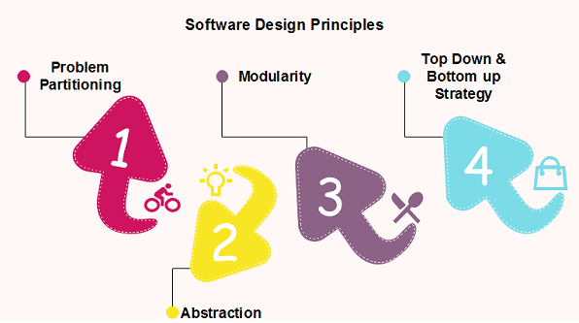
Cont…

Slide 11
1. Abstraction
An abstraction is a tool that enables a designer to consider a component at an abstract level without bothering about the internal details of the implementation.
Abstraction can be used for existing element as well as the component being designed

Slide 12
Cont…
Functional Abstraction
A module is specified by the method it performs.
The details of the algorithm to accomplish the functions are not visible to the user of the function.
Functional abstraction forms the basis for Function oriented design approaches.
Data Abstraction
Details of the data elements are not visible to the users of data. Data Abstraction forms the basis for Object Oriented design approaches.

Slide 13
Cont…
Functional Abstraction: A procedural abstraction refers to a sequence of instructions that have a specific and limited function. The name of a procedural abstraction implies these functions, but specific details are suppressed
Data Abstraction: A data abstraction is a named collection of data that describes a data object. A technique that simplifies data by removing unnecessary details and hiding complexities

Slide 14
2. architecture
Software architecture alludes to “the overall structure of the software and the ways in which that structure provides conceptual integrity for a system” [Sha95a].
In its simplest form, architecture is the structure or organization of program components (modules), the manner in which these components interact, and the structure of data that are used by the components

Slide 15
3. Pattern
The intent of each design pattern is to provide a description that enables a designer to determine (1) whether the pattern is applicable to the current work, (2) whether the pattern can be reused (hence, saving design time), and (3) whether the pattern can serve as a guide for developing a similar, but functionally or structurally different pattern

Slide 16
4. Separation of Concerns
Separation of concerns is a design concept that suggests that any complex problem can be more easily handled if it is subdivided into pieces that can each be solved and/or optimized independently.

Slide 17
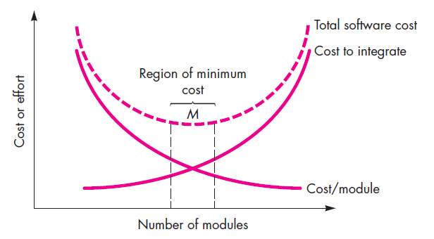
5. Modularity
Software is divided into separately named and addressable components, sometimes called modules, that are integrated to satisfy problem requirements.
It has been stated that “modularity is the single attribute of software that allows a program to be intellectually manageable

Slide 18
Properties of modularity
Each module is a well-defined system that can be used with other applications.
Each module has single specified objectives.
Modules can be separately compiled and saved in the library.
Modules should be easier to use than to build.
Modules are simpler from outside than inside.

Slide 19
Advantages
It allows large programs to be written by several or different people
It encourages the creation of commonly used routines to be placed in the library and used by other programs.
It simplifies the overlay procedure of loading a large program into main storage.
It provides more checkpoints to measure progress.
It provides a framework for complete testing, more accessible to test
It produced the well designed and more readable program.

Slide 20
Disadvantages
Execution time maybe, but not certainly, longer
Storage size perhaps, but is not certainly, increased
Compilation and loading time may be longer
Inter-module communication problems may be increased
More linkage required, run-time may be longer, more source lines must be written, and more documentation has to be done

Slide 21
Cohesion & Coupling
High cohesion. A cohesive design class has a small, focused set of responsibilities and single-mindedly applies attributes and methods to implement those responsibilities. For example, the class VideoClip might contain a set of methods for editing the video clip. As long as each method focuses solely on attributes associated with the video clip, cohesion is maintained.
Low coupling. Within the design model, it is necessary for design classes to collaborate with one another. However, collaboration should be kept to an acceptable minimum. If a design model is highly coupled (all design classes collaborate with all other design classes), the system is difficult to implement, to test, and to maintain over time.

Slide 22
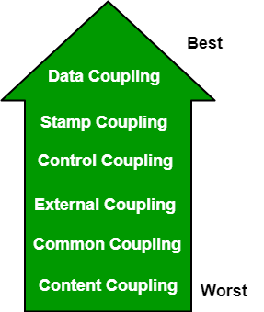
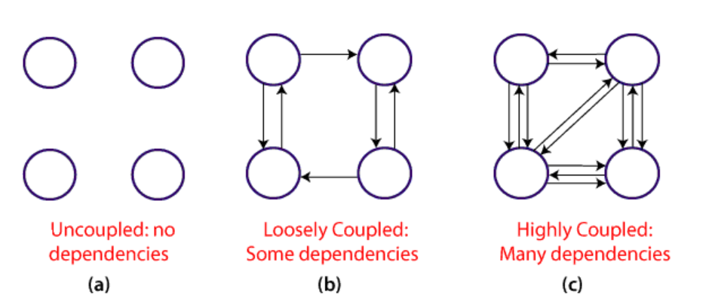
Types of coupling
https://www.tpointtech.com/software-engineering-coupling-and-cohesion

Slide 23
Contd…
Data Coupling: If the dependency between the modules is based on the fact that they communicate by passing only data, then the modules are said to be data coupled.
Stamp Coupling: Two modules are stamp coupled if they communicate using composite data items such as structure, objects, etc. When the module passes non-global data structure or entire structure to another module, they are said to be stamp coupled. For example, passing structure variable in C or object in C++ language to a module
Control Coupling: One module affects the behaviour of another by passing control information, often through parameters. E.g., Producer-consumer problem, if consumer does not consume then the producer will stop after some time
External Coupling: In external coupling, the modules depend on other modules, external to the software being developed or to a particular type of hardware.
Common Coupling: The modules have shared data such as global data structures. The changes in global data mean tracing back to all modules which access that data to evaluate the effect of the change.
Content Coupling: In a content coupling, one module can modify the data of another module, or control flow is passed from one module to the other module. This is the worst form of coupling and should be avoided.

Slide 24
Contd…
Temporal Coupling: Temporal coupling occurs when two modules depend on the timing or order of events, such as one module needing to execute before another
Sequential Coupling: Sequential coupling occurs when the output of one module is used as the input of another module, creating a chain or sequence of dependencies.
Communicational Coupling: Communicational coupling occurs when two or more modules share a common communication mechanism, such as a shared message queue or database.
Functional Coupling: Functional coupling occurs when two modules depend on each other’s functionality, such as one module calling a function from another module.
Interaction Coupling: Interaction coupling occurs due to the methods of a class invoking methods of other classes
Component Coupling: Component coupling refers to the interaction between two classes where a class has variables of the other class.

Slide 25
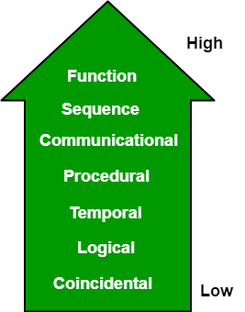
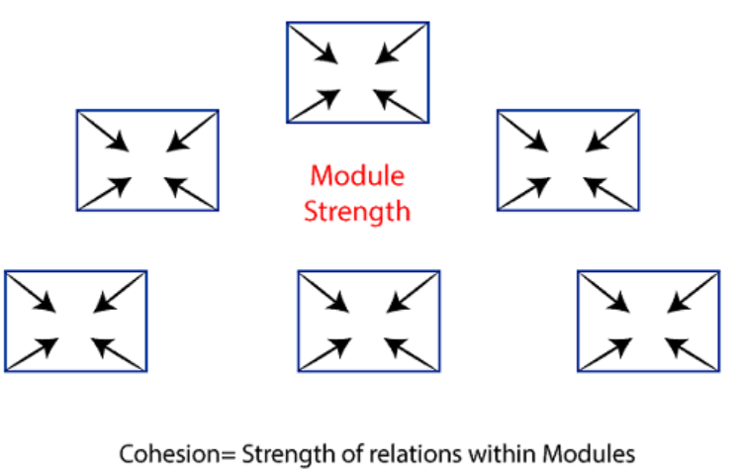
Types of Cohesion

Slide 26
Contd…
Functional Cohesion: Functional Cohesion is said to exist if the different elements of a module, cooperate to achieve a single function.
Sequential Cohesion: A module is said to possess sequential cohesion if the element of a module form the components of the sequence, where the output from one component of the sequence is input to the next.
Communicational Cohesion: A module is said to have communicational cohesion, if all tasks of the module refer to or update the same data structure, e.g., the set of functions defined on an array or a stack.
Procedural Cohesion: Here functions are related to each other through a flow control, i.e., they are part of an algorithm or procedure. e.g., the algorithm for decoding a message. Eg. Merge sort has partition and merge modules inside merge sort
Temporal Cohesion: When a module includes functions that are associated by the fact that all the methods must be executed in the same time, the module is said to exhibit temporal cohesion.
Logical Cohesion: A module is said to be logically cohesive if all the elements of the module perform a similar operation. For example Error handling, data input and data output, etc.
Coincidental Cohesion: A module is said to have coincidental cohesion if it performs a set of tasks that are associated with each other very loosely, if at all.

Slide 27
Contd…
Functional Cohesion: Every essential element for a single computation is contained in the component. A functional cohesion performs the task and functions. It is an ideal situation.
Sequential Cohesion: An element outputs some data that becomes the input for other element, i.e., data flow between the parts. It occurs naturally in functional programming languages.
Communicational Cohesion: Two elements operate on the same input data or contribute towards the same output data. Example- update record in the database and send it to the printer.
Temporal Cohesion: The elements are related by their timing involved. A module connected with temporal cohesion all the tasks must be executed in the same time span.
Logical Cohesion: The elements are logically related and not functionally. Ex- A component reads inputs from tape, disk, and network. All the code for these functions is in the same component. Operations are related, but the functions are significantly different.
Coincidental Cohesion: The elements are not related(unrelated). The elements have no conceptual relationship other than location in source code. It is accidental and the worst form of cohesion. Ex- print next line and reverse the characters of a string in a single component.
Procedural Cohesion: This type of cohesion occurs when elements or tasks are grouped together in a module based on their sequence of execution, such as a module that performs a set of related procedures in a specific order. Procedural cohesion can be found in structured programming languages.
Communicational Cohesion: Communicational cohesion occurs when elements or tasks are grouped together in a module based on their interactions with each other, such as a module that handles all interactions with a specific external system or module.
Informational Cohesion: Informational cohesion occurs when elements or tasks are grouped together in a module based on their relationship to a specific data structure or object, such as a module that operates on a specific data type or object. Informational cohesion is commonly used in object-oriented programming.

Slide 28
6. Information Hiding
modules should be specified and designed so that information (algorithms and data) contained within a module is inaccessible to other modules that have no need for such information

Slide 29
7. Functional Independence
Functional independence is achieved by developing modules with “singleminded” function and an “aversion” to excessive interaction with other modules.

Slide 30
8. Refinement
Refinement is actually a process of elaboration. You begin with a statement of function (or description of information) that is defined at a high level of abstraction.
The statement describes function or information conceptually but provides no information about the internal workings of the function or the internal structure of the information. You then elaborate on the original statement, providing more and more detail as each successive refinement (elaboration) occurs.

Slide 31
9. Aspects
a mechanism for understanding how global requirements affect design!
10. Refactoring
Refactoring is the process of changing a software system in such a way that it does not alter the external behavior of the code [design]
yet improves its internal structure.”

Slide 32
11. Object-Oriented Design Concepts
The object-oriented (OO) paradigm is widely used in modern software engineering
12. Design Classes
The requirements model defines a set of analysis classes (Chapter 6). Each describes some element of the problem domain, focusing on aspects of the problem that are user visible. The level of abstraction of an analysis class is relatively high.
As the design model evolves, you will define a set of design classes that refine the analysis classes by providing design detail that will enable the classes to be implemented, and implement a software infrastructure that supports the business solution

Slide 33
Types of Design Classes
User interface classes – define all abstractions necessary for human-computer interaction
Business domain classes – refined from analysis classes; identify attributes and methods that are required to implement some element of the business domain
Process classes – implement business abstractions required to fully manage the business domain classes
Persistent classes – represent data stores (e.g., a database) that will persist beyond the execution of the software
System classes – implement software management and control functions that enable the system to operate and communicate within its computing environment and the outside world

Slide 34
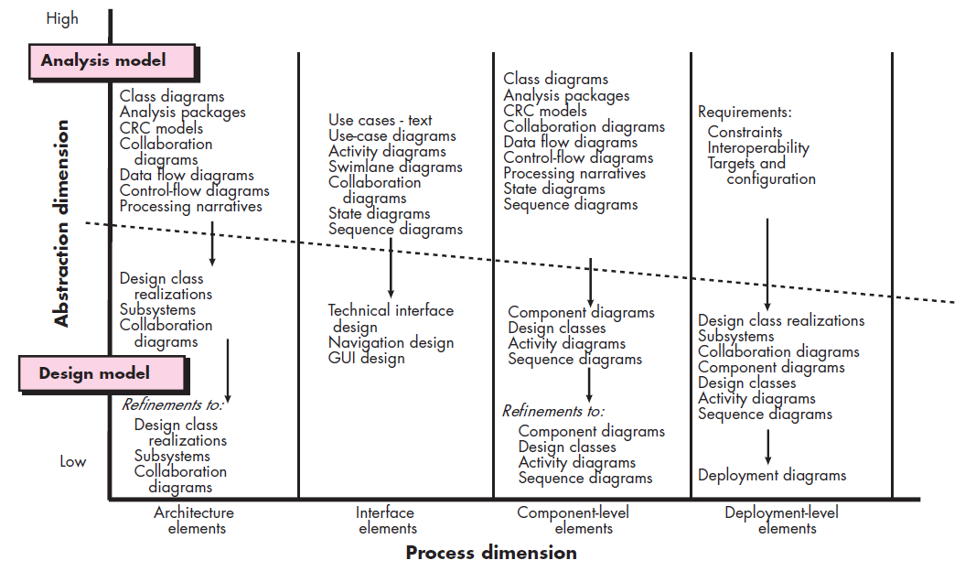
interface design and component-level
design, which often occur in paralle
are not always developed in a sequential fashion

Slide 35
Design Model Elements
Data Design elements
Architectural Design elements
Interface Design elements
Component Design elements
Deployment Design elements

Slide 36
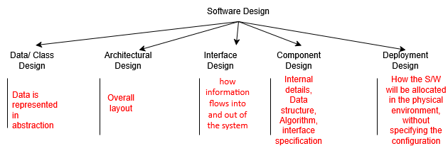
Software Design Components

Slide 37
Data/Class Design Elements
Data design creates a model of data and objects that is represented at a high level of abstraction
This data model is then refined into progressively progressively more implementation-specific representations that can be processed by the computer-based system
At the program component level, the design of data structures and the associated algorithms are used for the creating the high-quality applications.
At the application level, the translation of a data model into a database is essential to achieve the business objectives of a system.
At the business level, the collection of information stored in different databases and reorganized into a data warehouse enables data mining or knowledge discovery.

Slide 38
Architectural Elements
Architectural design depicts the overall layout of the software
The architectural model is derived from three sources:
(1) Information about the application domain
(2) Specific requirements model elements such as data flow diagrams and their relationships
(3) The availability of architectural styles and patterns.
The architectural design element is usually represented as a set of interconnected subsystems, each have its own architecture

Slide 39
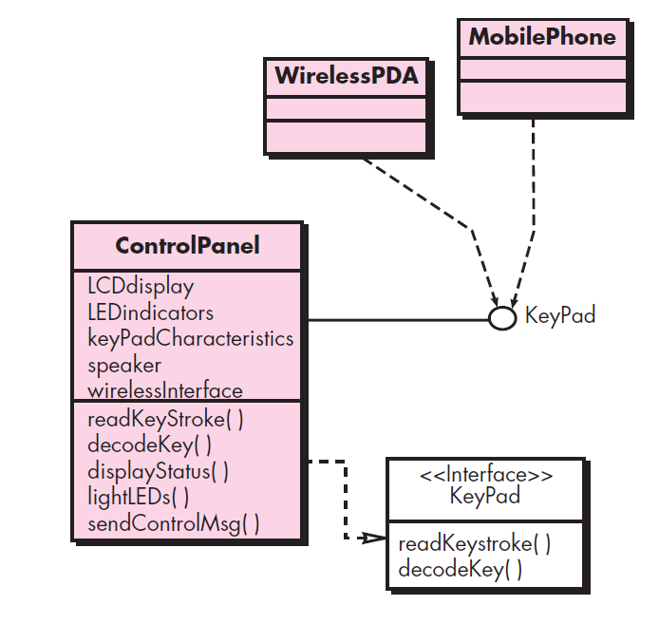
Interface design elements
Interface design tells how information flows into and out of the system and how it is communicated among the various components of the architecture
Elements of interface design:
user interface
external interfaces
internal interfaces

Slide 40

Component Design Elements
Component level design describes the internal detail of each software component like data structure definitions, algorithms, and interface specifications.
A UML activity diagram can be used to represent processing logic.
Pseudocode or some other diagrammatic form (e.g., flowchart or box diagram) is used to represent the detailed procedural flow between the component.
Algorithmic structure follows the rules established for structured programming
SensorManagement
Sensor

Slide 41
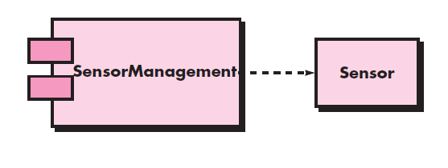
Component Level Design Elements - Example
A component named SensorManagement (part of the SafeHome security function) is represented. A dashed arrow connects the component to a class named Sensor that is assigned to it. The SensorManagement component performs all functions associated with SafeHome sensors including monitoring and configuring them

Slide 42
Deployment Level Design Elements
Deployment-level design elements indicate how software functionality and subsystems will be allocated within the physical computing environment that will support the software
The deployment diagram shows the computing environment but does not explicitly indicate configuration details. For example, the “personal computer” is not further identified. It could be a Mac or a Windows-based PC, a Sun workstation, or a Linux-box.
These details are provided when the deployment diagram is revisited in instance form during the latter stages of design or as construction begins

Slide 43
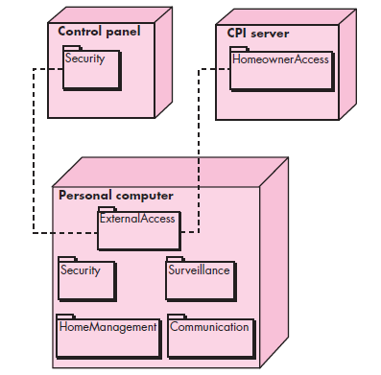
Deployment-level design elements
This design indicates how software functionality and subsystems will be allocated within the physical computing environment that will support the software

Slide 45
Software Architecture Design
Architectural Styles
Architectural Design
Architectural Mapping

Slide 46



Why Architecture?
Architecture of a system describes the components and how they fit together.
Architecture enables a software engineer to:
analyze the effectiveness of the design in meeting its stated requirements,
consider architectural alternatives at a stage when making design changes is still relatively easy, and
reduce the risks associated with the construction of the software.

Slide 47
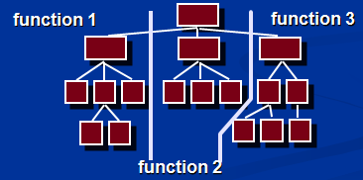
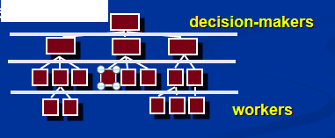
Horizontal & Vertical Partitioning
Horizontal Partitioning define separate branches of the module hierarchy for each major function
This use control modules to coordinate communication between functions
Vertical Partitioning: Factoring
Vertical partitioning suggests the control and work should be distributed top-down in the program structure.
The decision making modules should reside at the top of the architecture

Slide 48





Architectural Styles
The architectural styles is used to describes a system which has :
set of components (e.g., a database, computational modules) that perform a function required by a system,
set of connectors that enable “communication, coordination and cooperation” among components,
constraints that define how components can be integrated to form the system, and
semantic models that enable a designer to understand the overall properties of a system by analyzing the known properties of its constituent parts.

Slide 49
Taxonomy of Styles in Software
Data-centered architectures
There is a central data server which is accessed by clients
Data flow architectures
Data travels through a series of components
Call and return architectures
Classical
Object-oriented architectures
Modern style. Components pass messages
Layered architectures
High-level to machine level

Slide 50
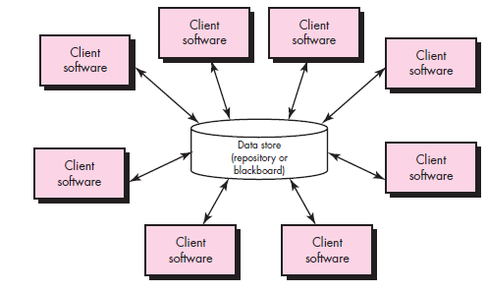
Data-Centered Architecture

Slide 51
Data-Centered Architecture
A data store (e.g., a file or database) resides at the center of this architecture and is accessed frequently by other components that update, add, delete, or modify data within the store.
The main goal is to integrate the data
The shared data may be a passive repository or an active blackboard
Passive repository means the client software accesses the data independent of any changes to the data or the actions of other client software.
A variation on this approach transforms the repository into a “blackboard”
A blackboard notifies subscriber clients when changes occur in data of interest

Slide 52
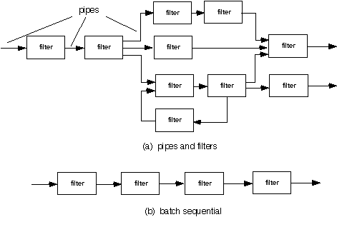
Data Flow Architecture
This architecture is used when input has to be transformed into output through a series of computational components.
The main goal is modifiability
Pipe-and-filter style
A pipe-and-filter pattern has a set of components, called filters, connected by pipes that transmit data from one component to the next.
The filters incrementally transform the data
The filter does not require knowledge of the workings of its neighboring filters.
Batch sequential style
If the data flow degenerates into a single line of transforms, it is termed batch sequential.
This structure accepts a batch of data and then applies a series of sequential components (filters) to transform it.

Slide 53
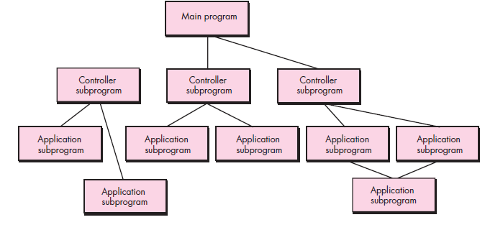
Call and Return Architecture
This architectural style enables to achieve a program structure that is relatively easy to modify and scale.
Substyles of call and return architecture:
Main program/subprogram architectures
This style decomposes the function into a control hierarchy where a main program invokes a number of program components which in turn may invoke other components.
Remote procedure call architectures
The components of a main program/subprogram architecture are distributed across multiple computers on a network.

Slide 54
Object-oriented architectures
The components of a system encapsulate data and the operations that are applied to manipulate the data.
Communication between components are accomplished through message passing.

Slide 55
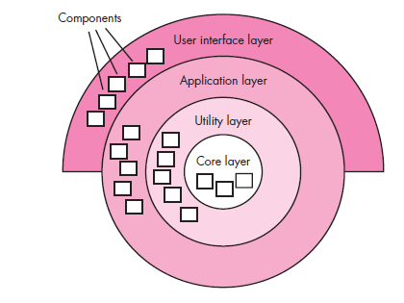
Layered Architecture
A number of different layers are defined, each accomplishing operations that progressively become closer to the machine instruction set.
At the outer layer, components service user interface operations.
At the inner layer, components perform operating system interfacing.
Intermediate layers provide utility services and application software functions.

Slide 56
ARCHITECTURAL DESIGN PROCESS
Architectural Design Steps
Represent the system in context
Define archetypes
Refine the architecture into components
Describe instantiations of the system

Slide 57
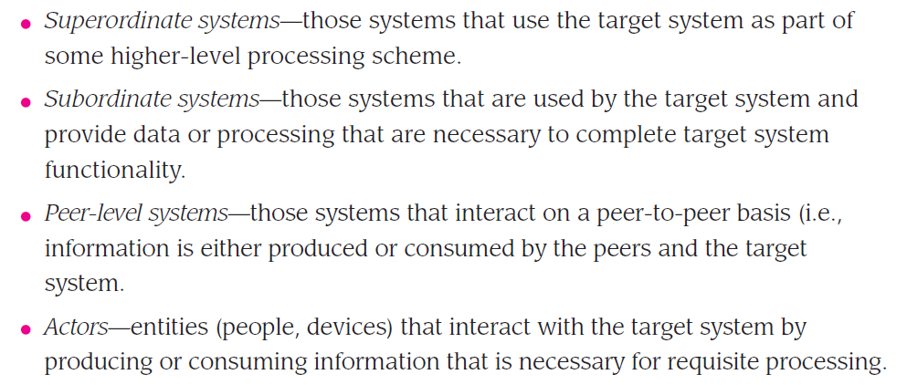
Step 1: Represent the system in context

Slide 58
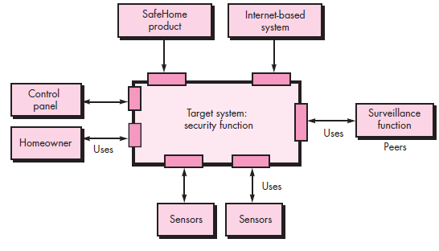
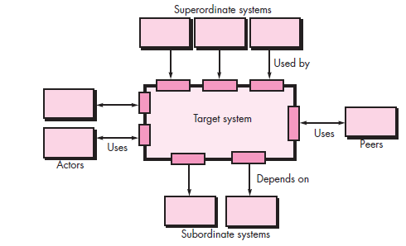
1. Represent the System in Context

Slide 59
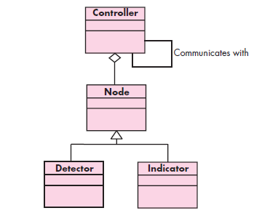
2. Define Archetypes
An archetype is a class or pattern that represents a core abstraction of the target system.
In general, a relatively small set of archetypes is required to design even relatively complex systems
An archetype is something that serves
as a model or a basis for something.
This is because it is believed to have all
the essential characteristics of becoming
something or someone.

Slide 60
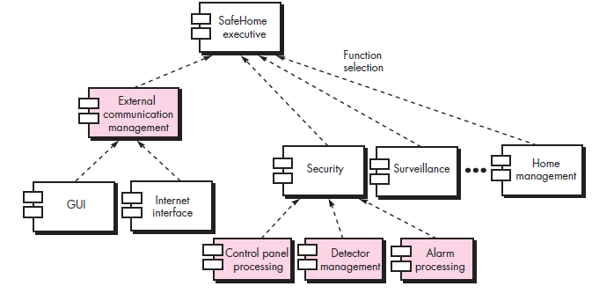
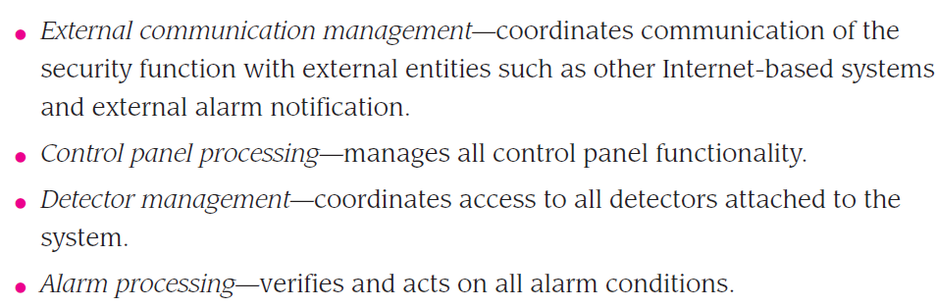
3. Refine the Architecture into Components (major software components are identified.)

Slide 61
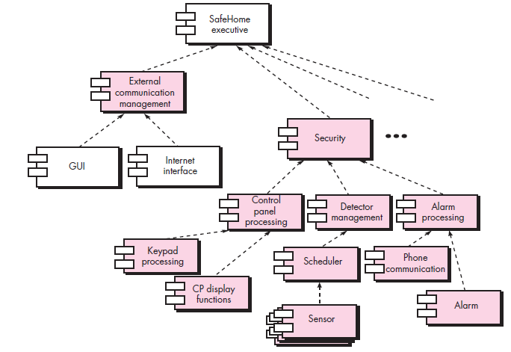
4. Describe Instantiations of the System

Slide 62
Architectural Mapping
design steps that allows a DFD with transform flow characteristics to be mapped into a specific architectural style
Types of information flow
The 2 different types of information flows:
Transaction flow - a single data item triggers information flow along one of many paths
Transform flow
overall data flow is sequential and flows along a small number of straight-line paths
Incoming Flow: The paths that transform the external data into an internal form
Transform Center: The incoming data are passed through a transform center and begin to move along paths that lead it out of the software
Outgoing Flow: The paths that move the data out of the software

Slide 63
Steps Involved
Step 1. Review the fundamental system model.
Step 2. Review and refine data flow diagrams for the software.
Step 3. Determine whether DFD has transform or transaction flow characteristics
Step 4. Isolate the transform center by specifying incoming and outgoing flow boundaries
Step 5. Perform “first-level factoring”
Step 6. Perform “second-level factoring”
Step 7. Refine the first iteration program structure using design heuristic

Slide 64
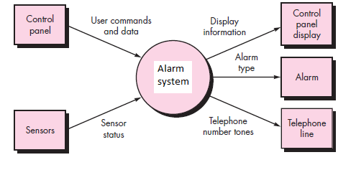
Step 1. Review the fundamental system model.
SAFE HOME PROJECT

Slide 65
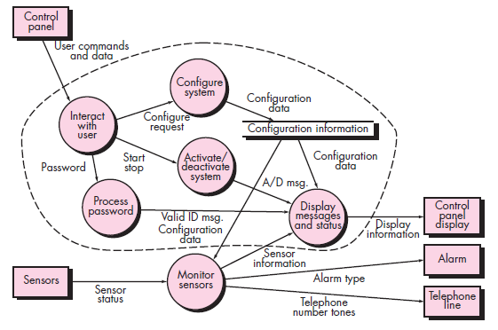
Step 2. Review and refine data flow diagrams for the software.

Slide 66
Step 3. Determine whether DFD has transform or transaction flow characteristics.
in general---transform flow
special case---transaction flow

Slide 67
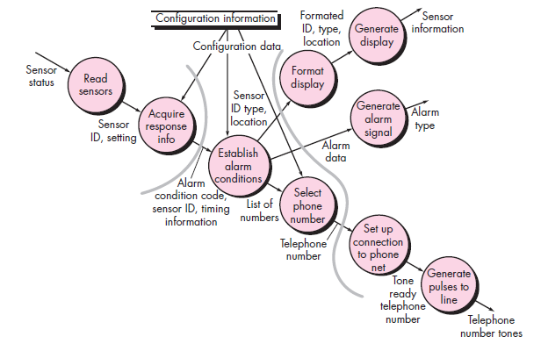
Step 4. Isolate the transform center by specifying incoming and outgoing flow boundaries
we see data entering the software
along one incoming path and exiting along three outgoing paths. Therefore, an
overall transform characteristic will be assumed for information flow.

Slide 68
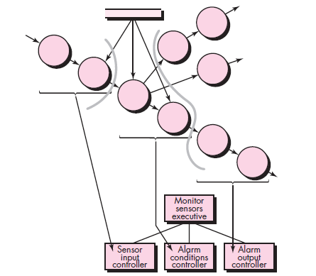
Step 5. Perform “first-level factoring”

Slide 69
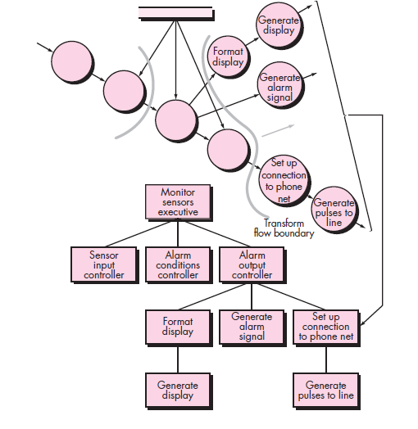
Step 6. Perform “second-level factoring”
Incoming and outgoing flow boundaries are open to interpretation.
That is, different designers may select slightly different points in the flow as boundary
locations.

Slide 70
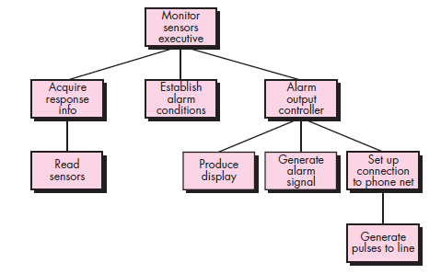
Step 7: Refine the first iteration program structure using design heuristics

Slide 71
Types
Top-down Approach
Bottom-up Approach

Slide 72
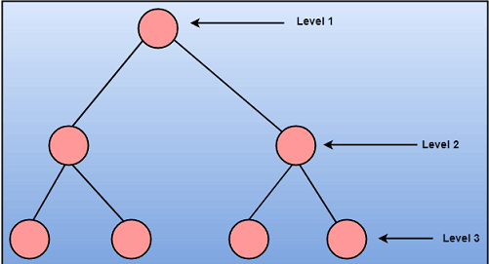
Top-Down

Slide 73
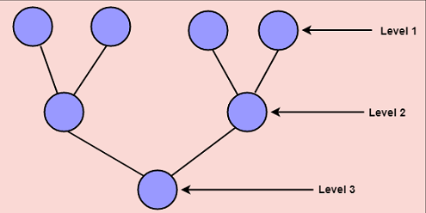
Bottom-Up

Slide 74
Cont…
Top-down Approach: This approach starts with the identification of the main components and then decomposing them into their more detailed sub-components.
Bottom-up Approach: A bottom-up approach begins with the lower details and moves towards up the hierarchy, as shown in fig. This approach is suitable in case of an existing system.

Slide 75
Appendix: SafeHome Project
It’s an Alarm system for Home.
The home security function would protect against and/or recognize a variety of undesirable “situations” such as illegal entry, fire, flooding, carbon monoxide levels, and others. It’ll use our wireless sensors to detect each situation. It can be programmed by the homeowner, and will automatically telephone a monitoring agency when a situation is detected.

